Slide 1
GSU - Image Processing
Cirelli, Chris
Hwang, Yun
Nguyen, Phuong

Slide 2
Agenda
Introduction to the problem and dataset
License Plate Recognition
Primary Challenge #1: Lack of Homogeneous Images
Primary Challenge #2: Identify Contour Associated w/ License Plate
Optical Character Recognition
Primary Challenge #1: Noise
Primary Challenge #2: Tilting
Results
Conclusion

Slide 3
Introduction To Objective & Dataset
Objective
The objective of this project was to create a program that can detect the license plate from an image and crop it for identification.
Dataset
The dataset contains 1821 images, captured by a license plate reader (LPR).
“Context” image showing the vehicle, each image is 800 x 600 pixels
“IR_patch” image showing the cropped license plate
“XML” file contains metadata

Slide 4
Preprocessing Images
Convert image into grayscale
Gaussian blur to blur details and noises
Find edges of car using canny edge

Slide 5
License Plate Recognition
Challenge 1: Lack of Homogeneous Images

Slide 6
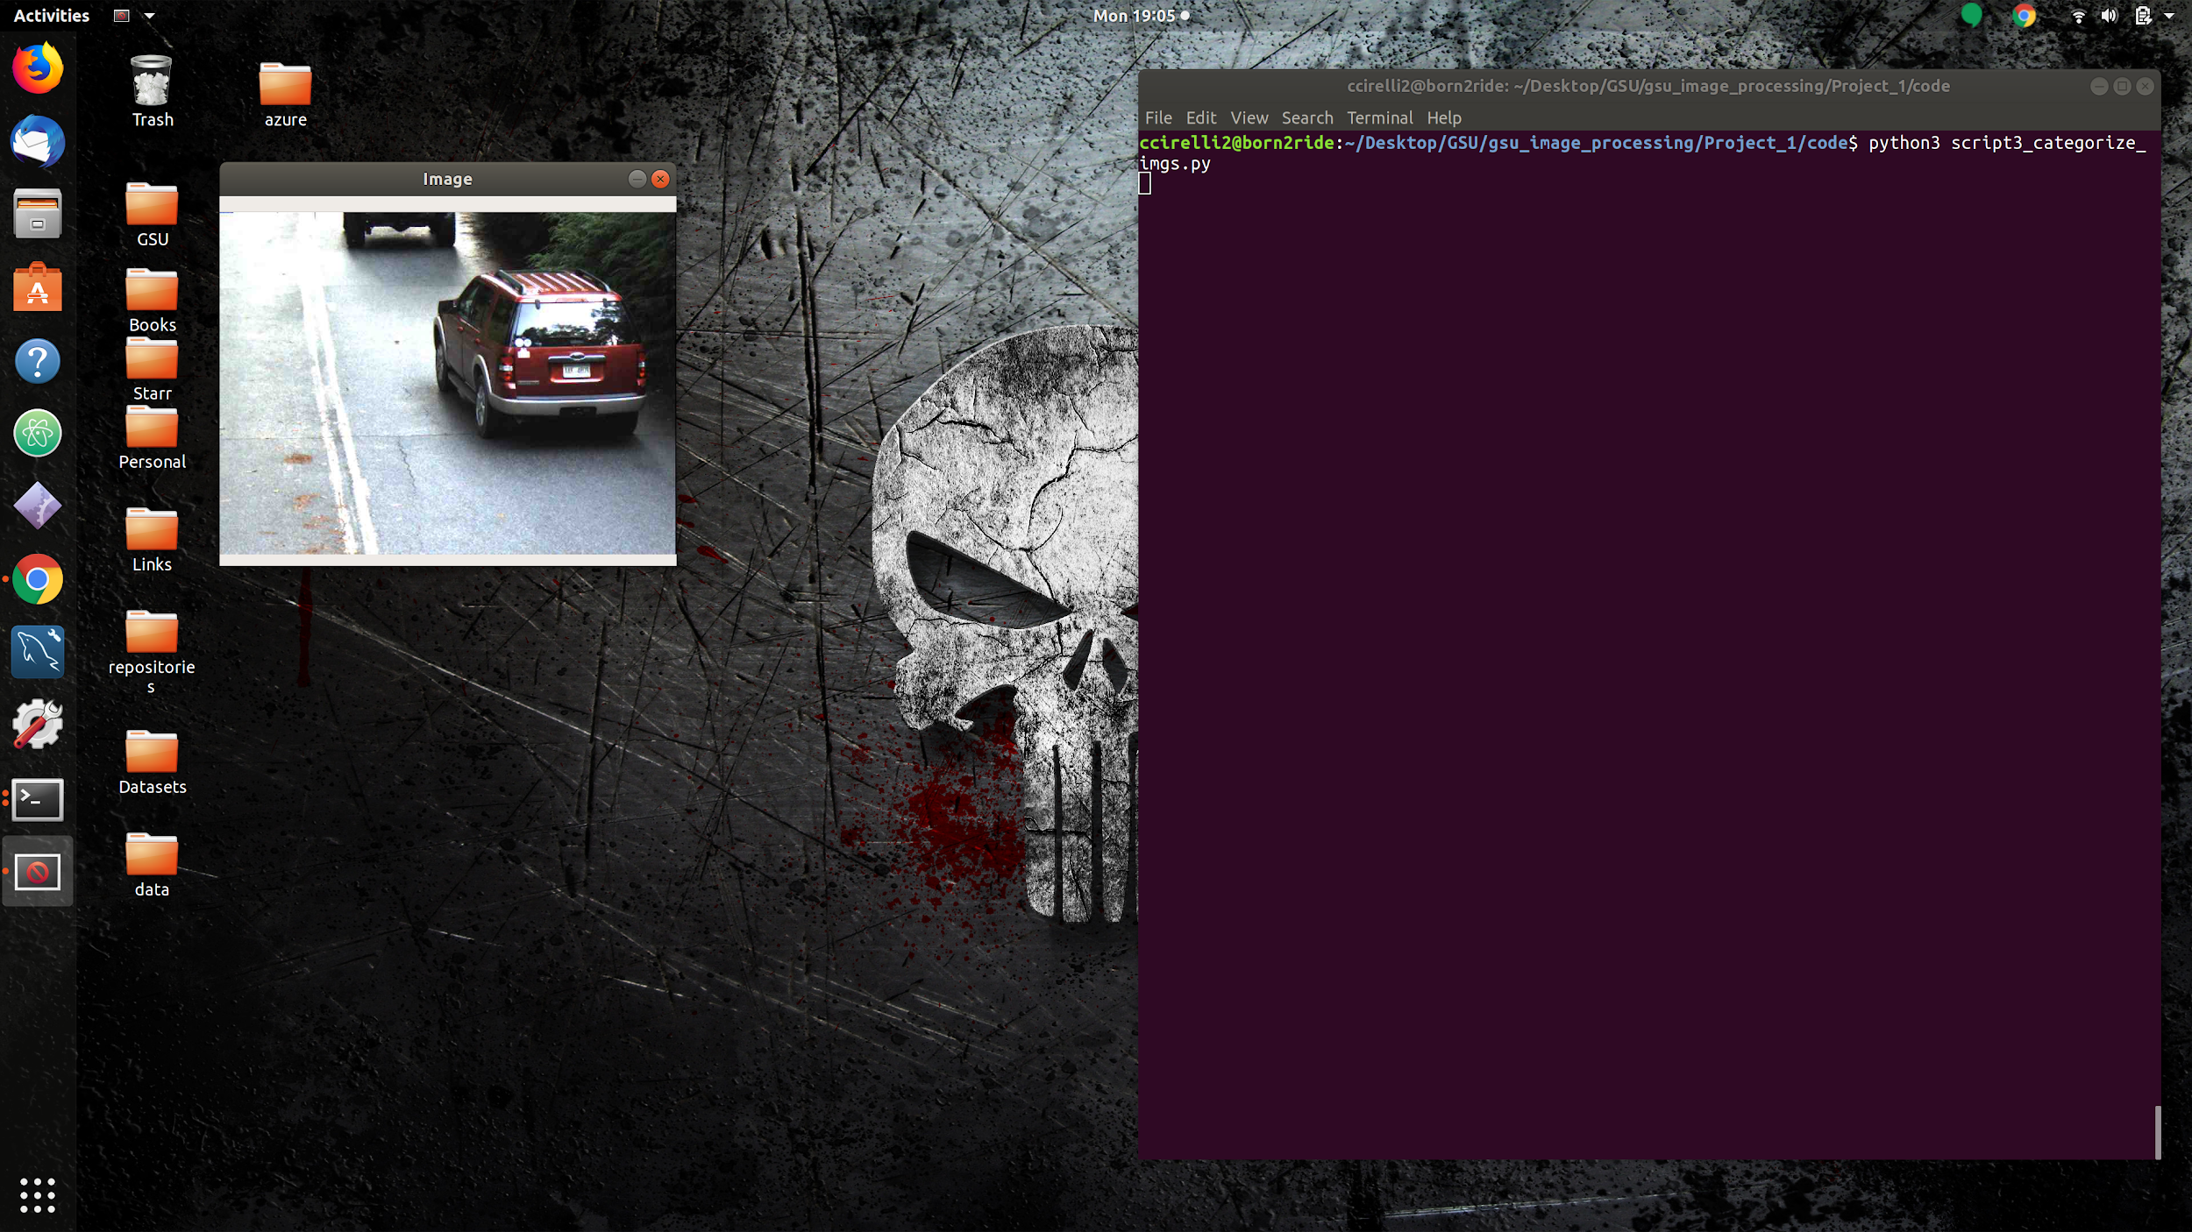
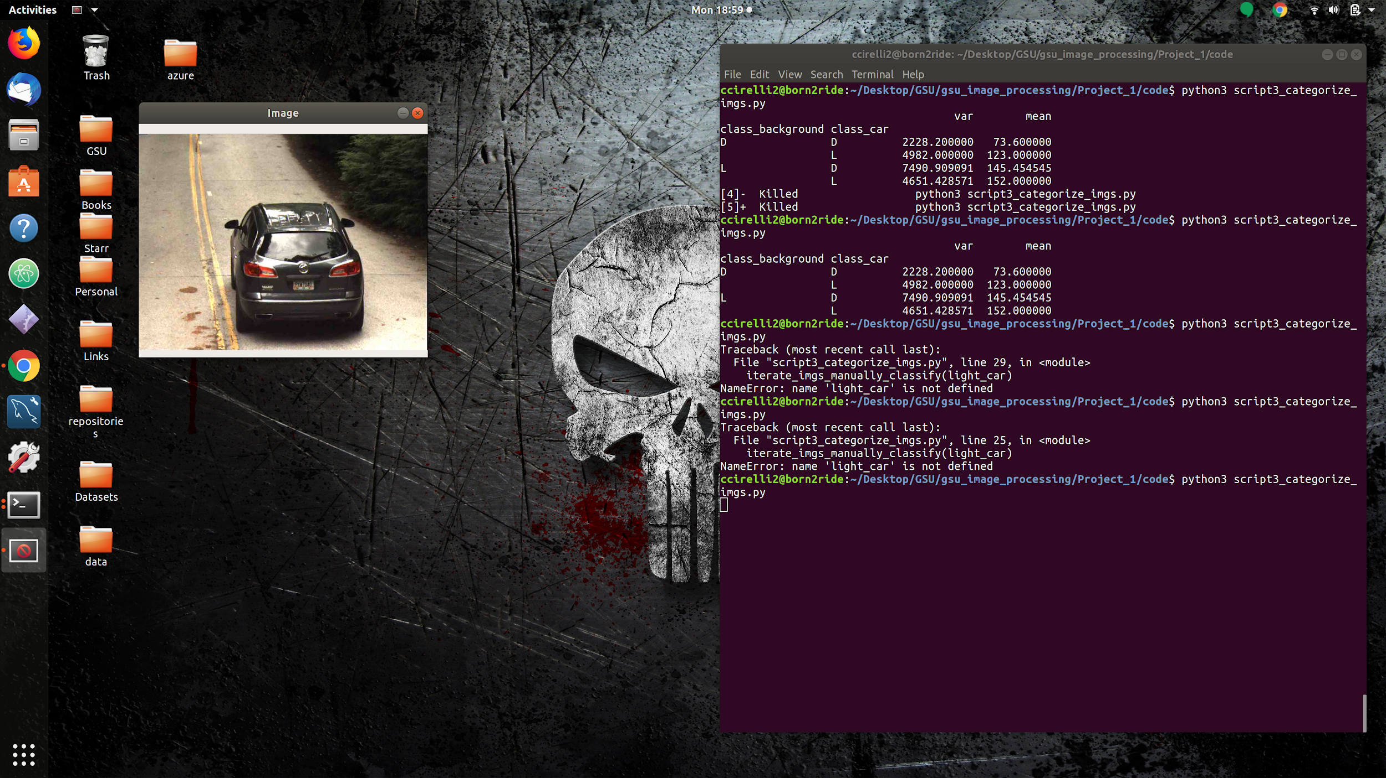
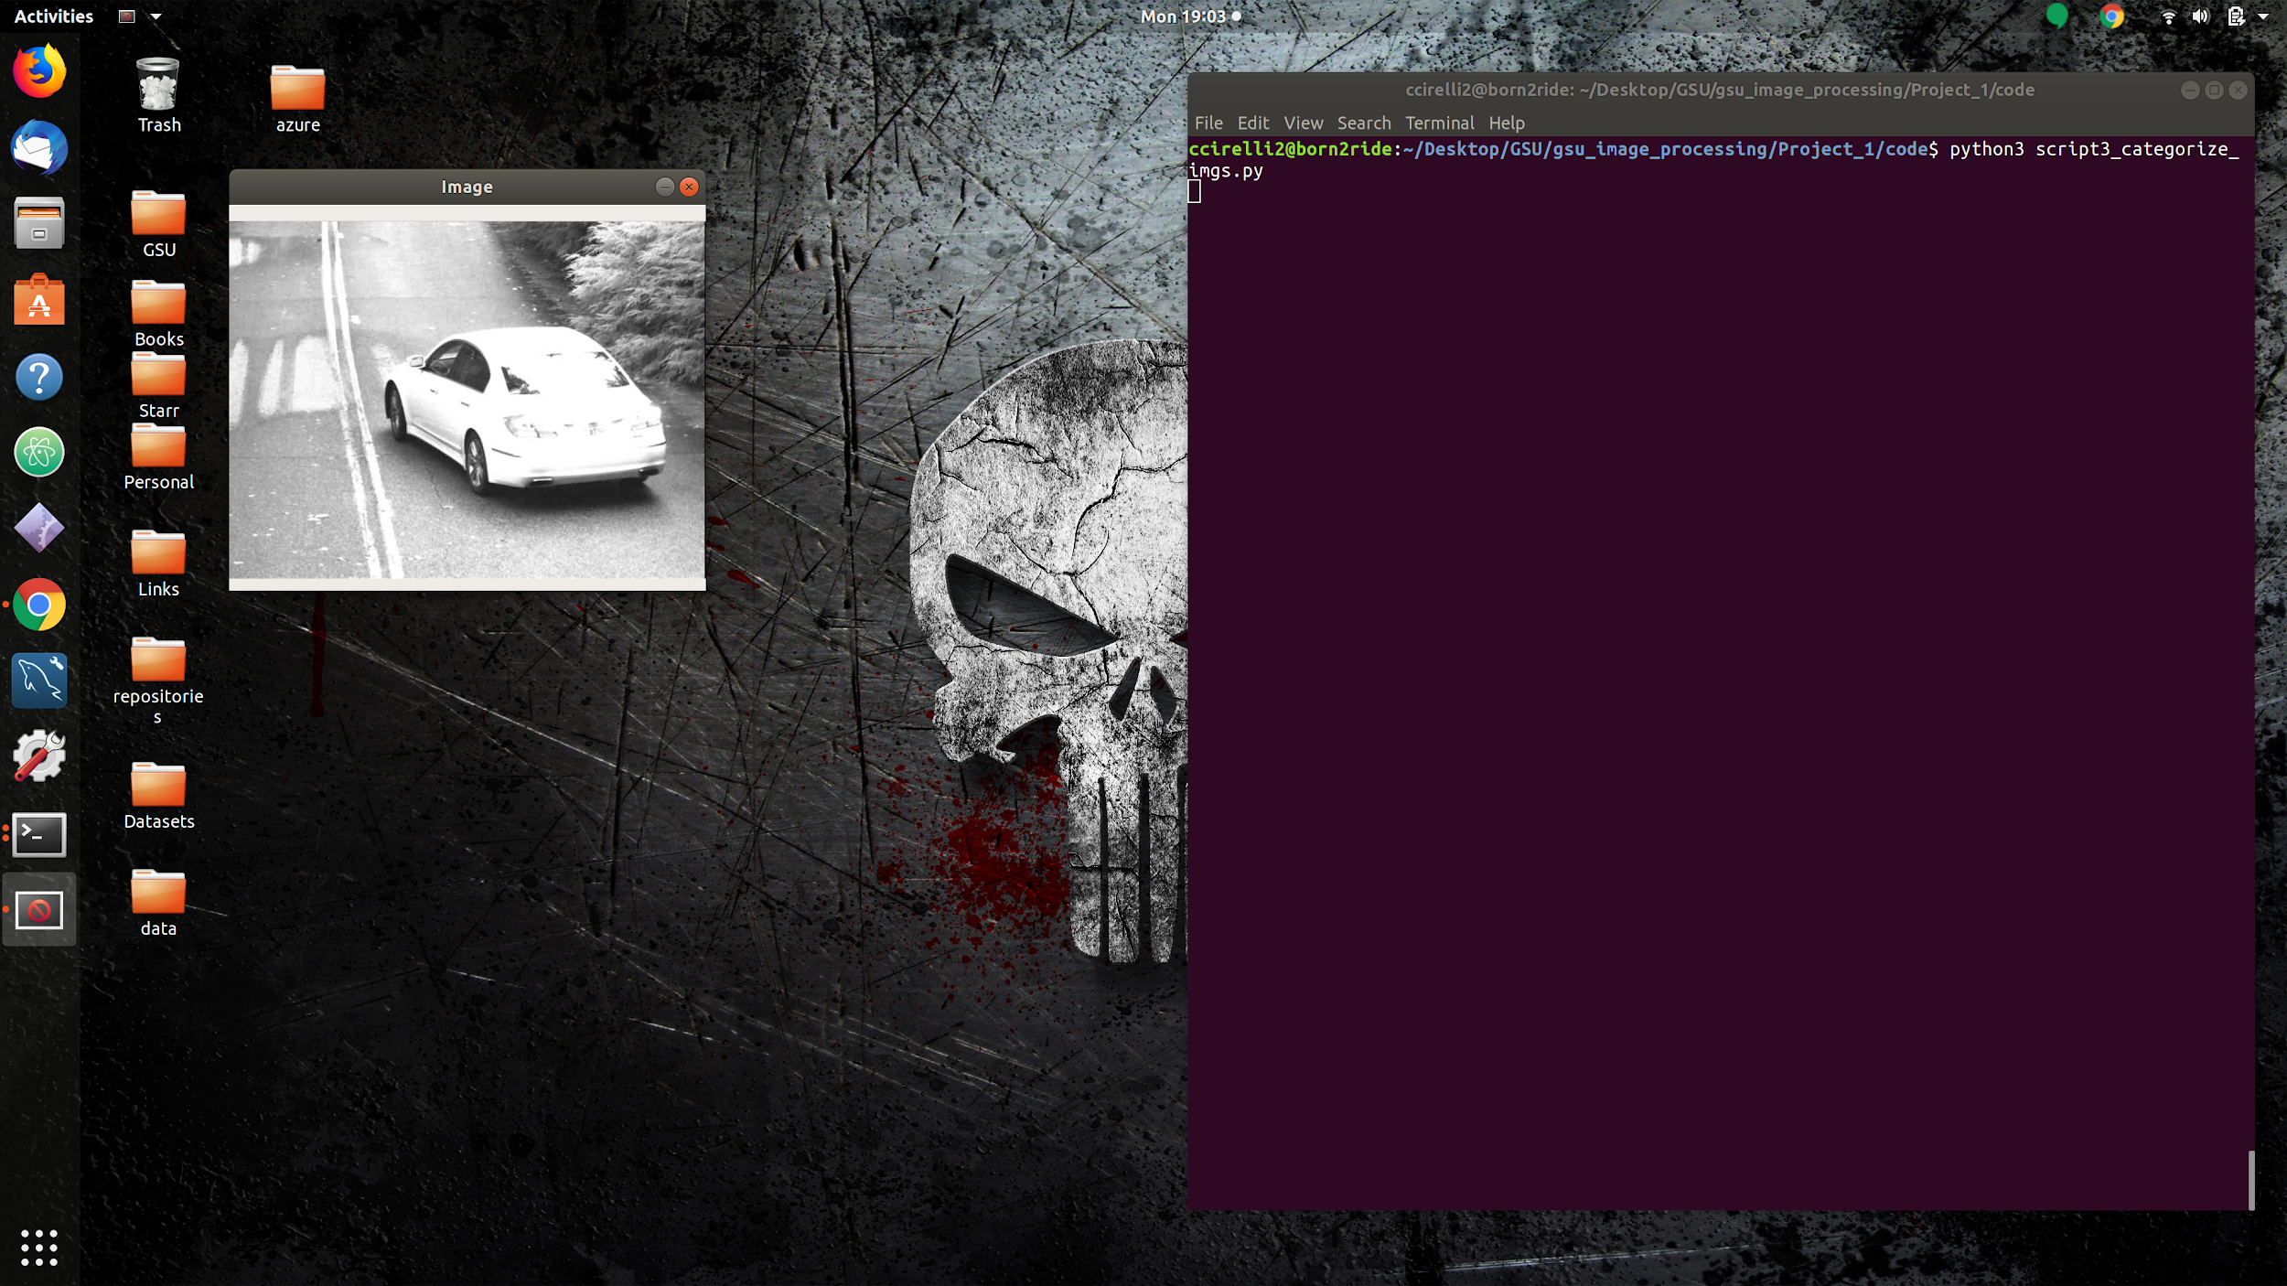
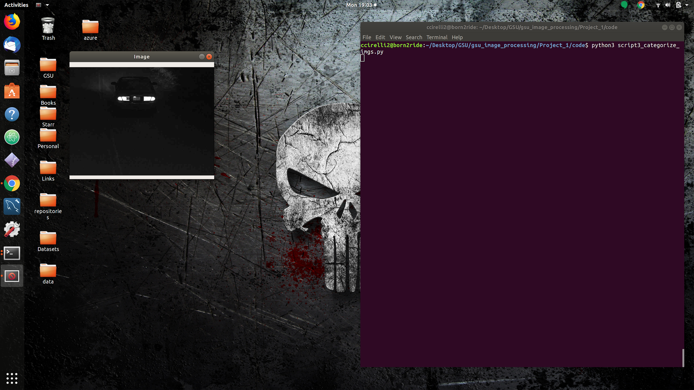
Examples of Different Images
Lack of homogeneity
Creates difficulties using a single approach to capture image roi’s.
Ideally we would to process each type of image differently.

Slide 7
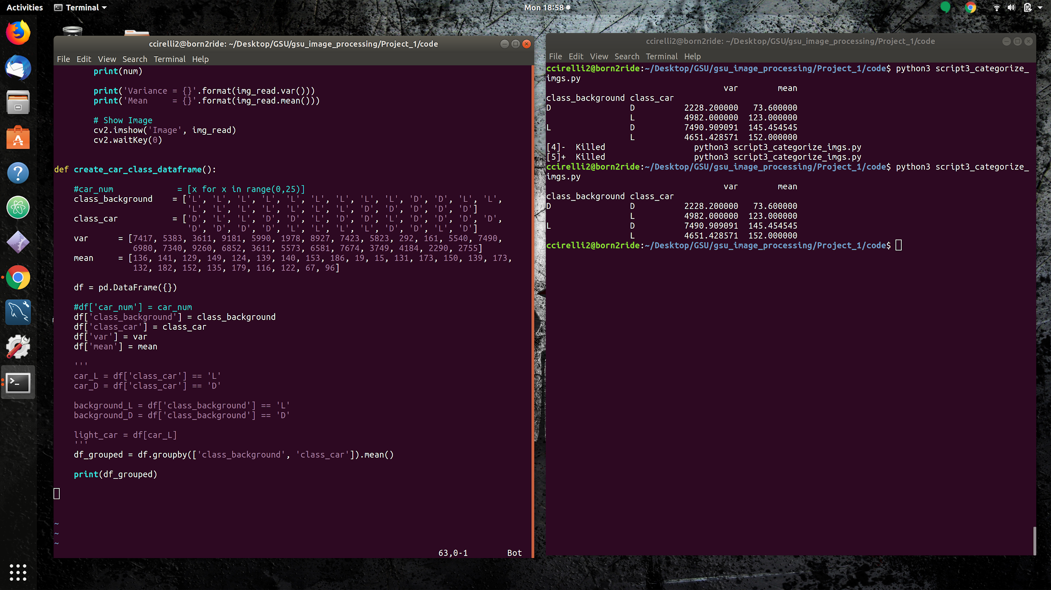
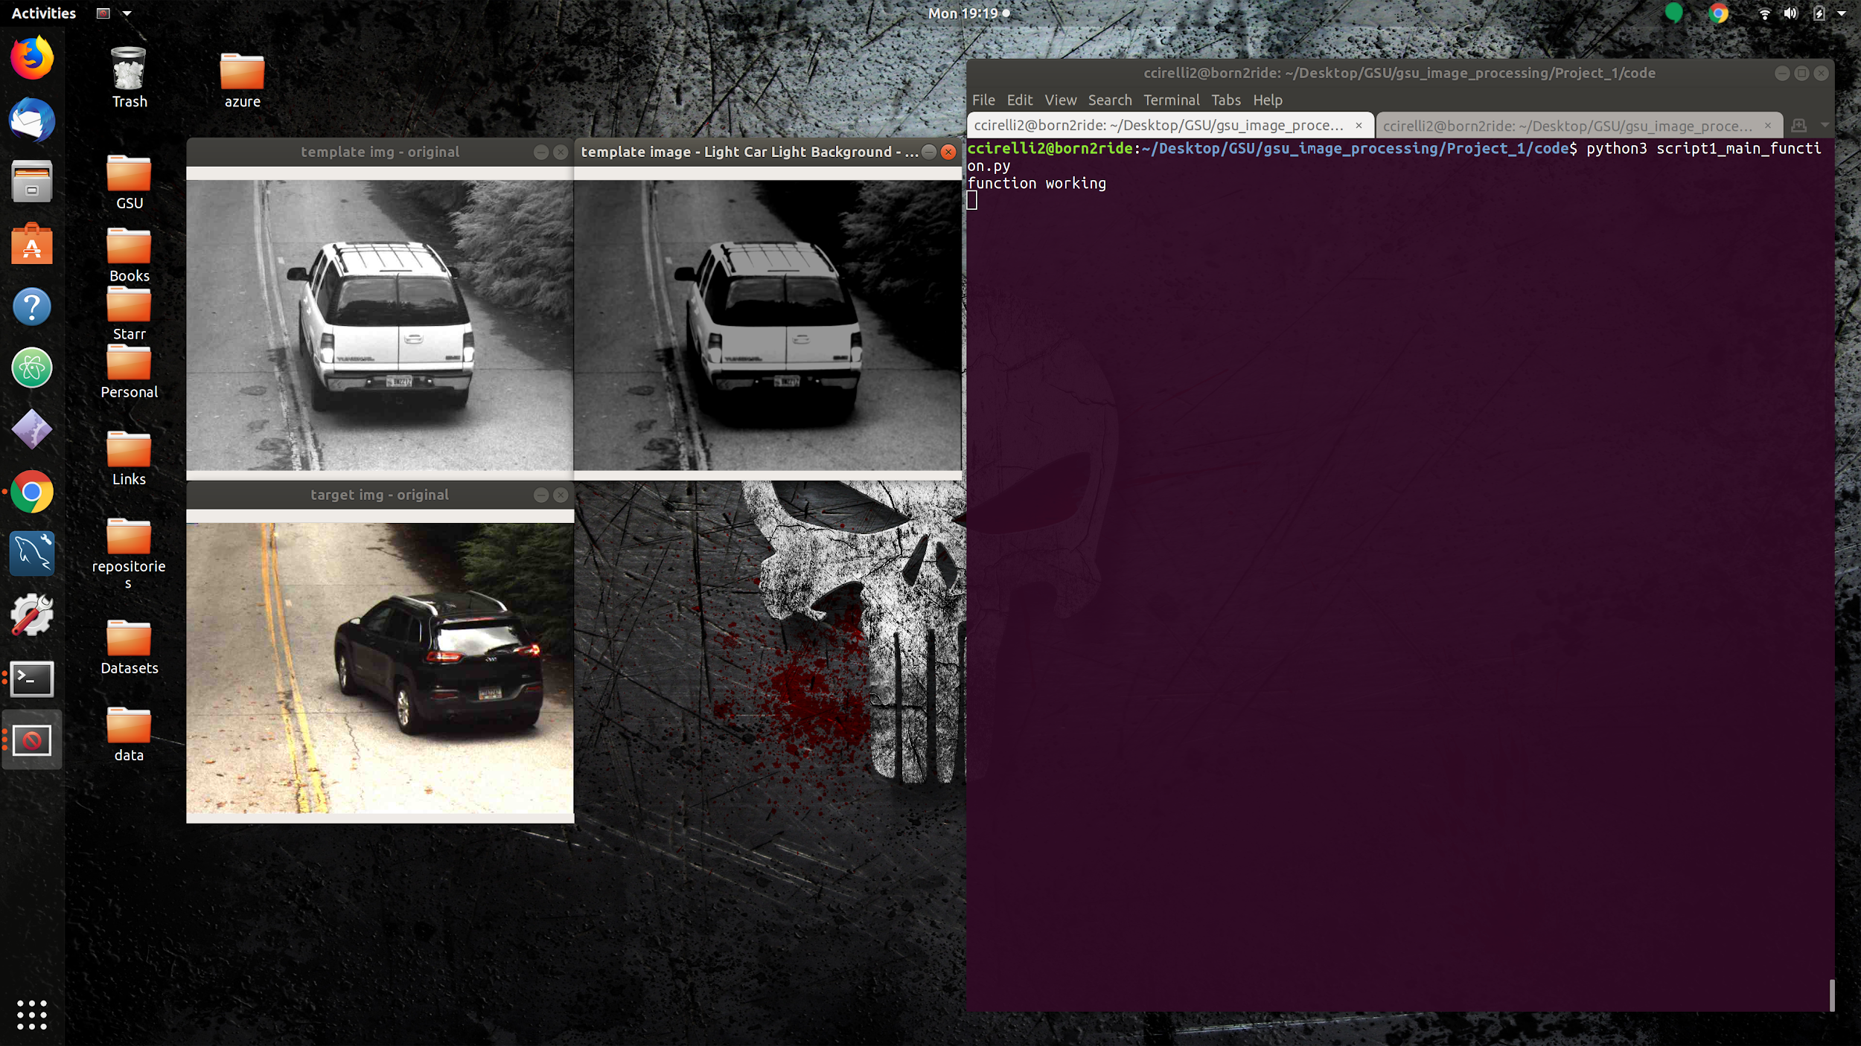
Approach 1: Image Intensity Recognition
Classify & Group Images
Approach 1:
Utilize image intensity variance and mean to differentiate images.
Group Average Var & Mean:
Categories:
Light Car, Light Background
Light Car, Dark Background
Dark Car, Light Background
Dark Car, Dark Background
Original Img Classified & Processed:
Modular Pre-Processing:
L_car, L_background: Darken image
D_car, D_background: Inverse Threshold

Slide 8
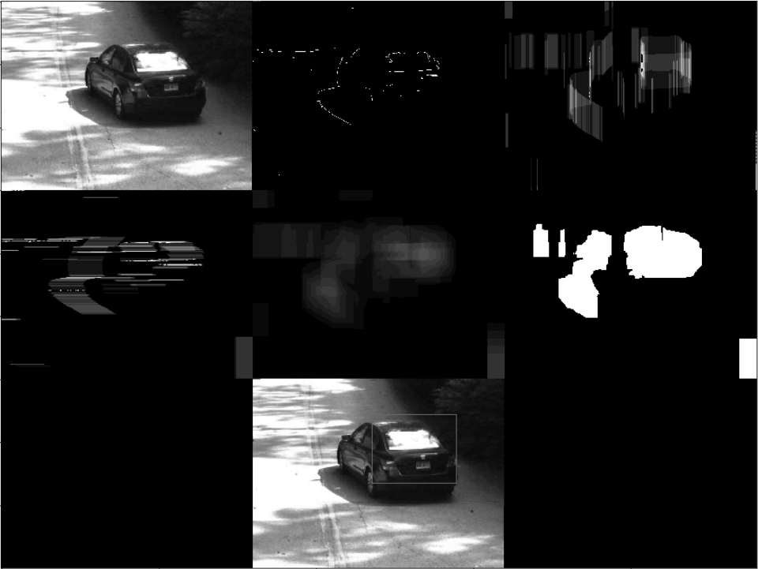
Approach 2: Region of Interest Detection
Approach 2:
(From top left to right)
Grayscale
Tight Canny Edge
Vertical Motion Blur
Horizontal Motion Blur
Merging number 3 and 4
Binary Threshold
Target Area
Add Images here

Slide 9
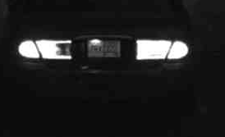
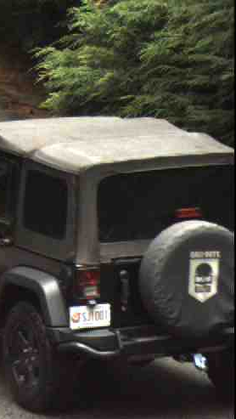
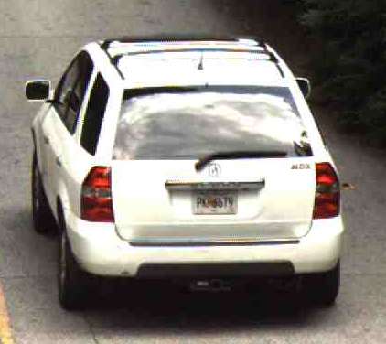
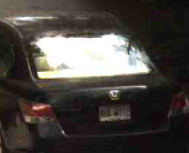
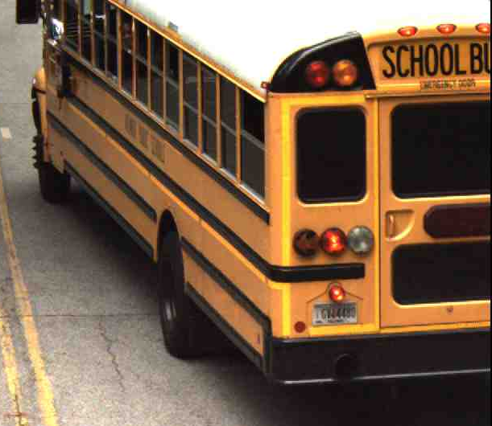
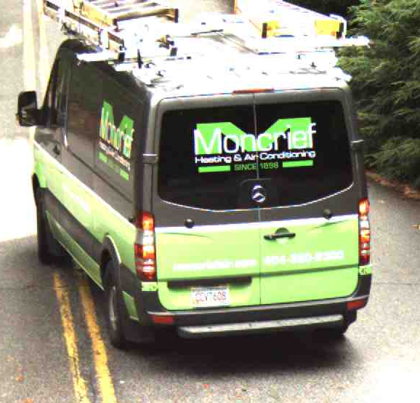
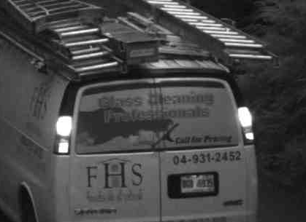
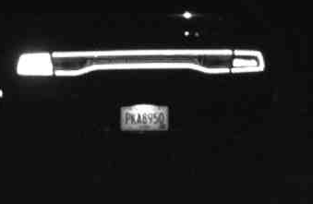
Approach 2: Region of Interest Detection

Slide 10
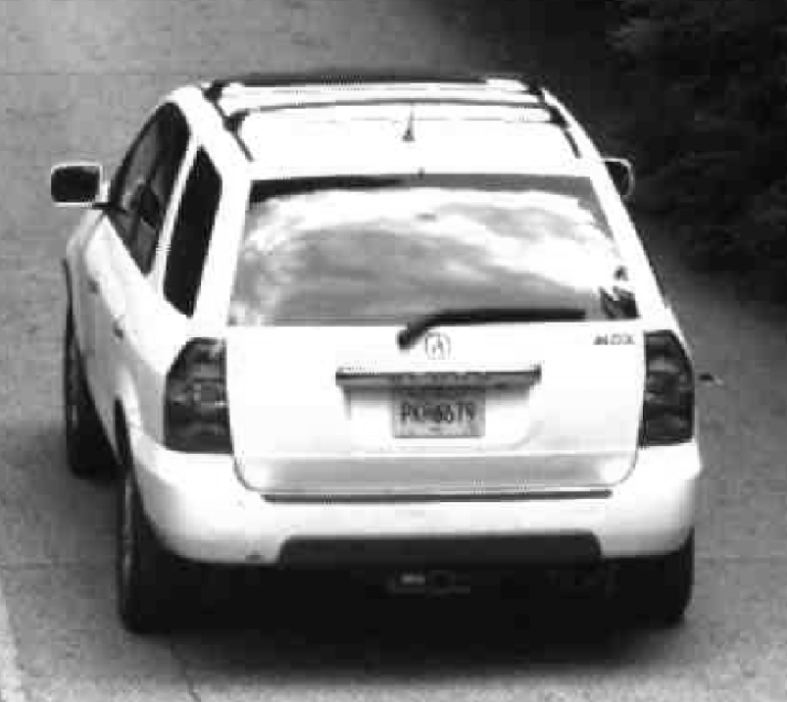
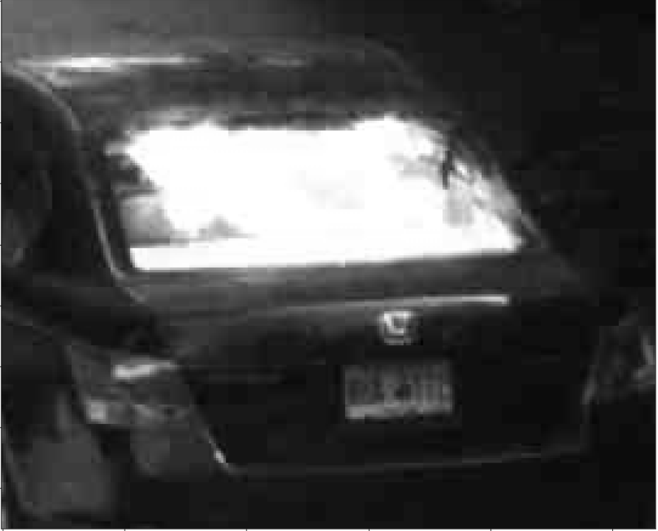
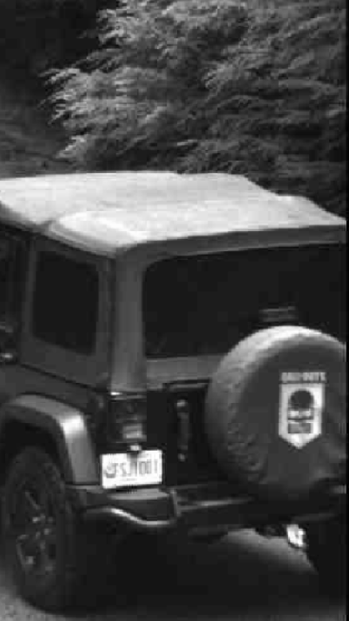
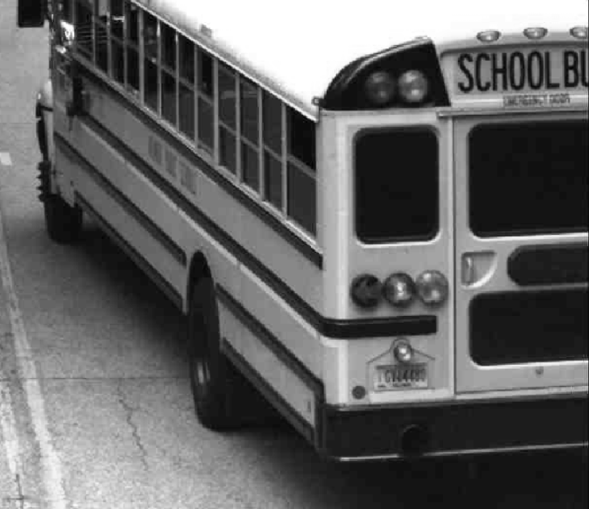
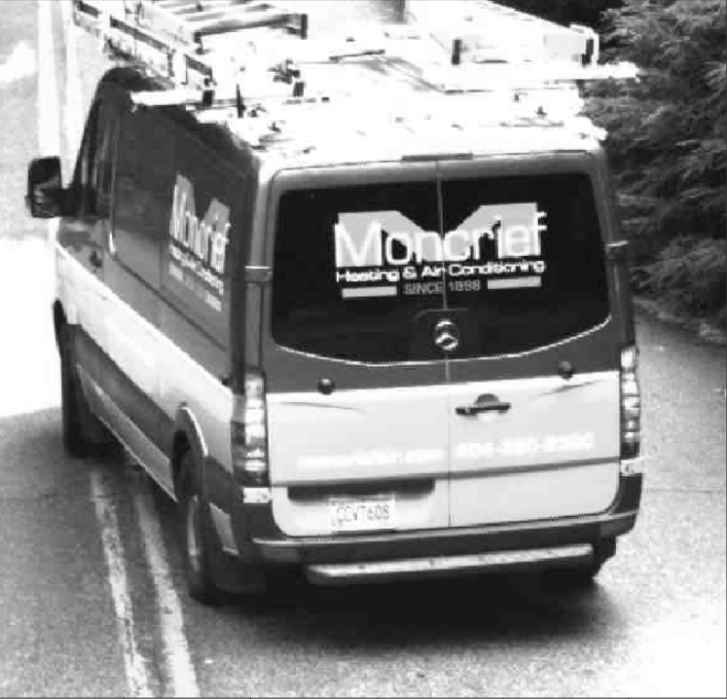
Approach 2: Region of Interest Detection

Slide 11
License Plate Recognition
Challenge 2: Identify Contour Associated w/ License Plate

Slide 12
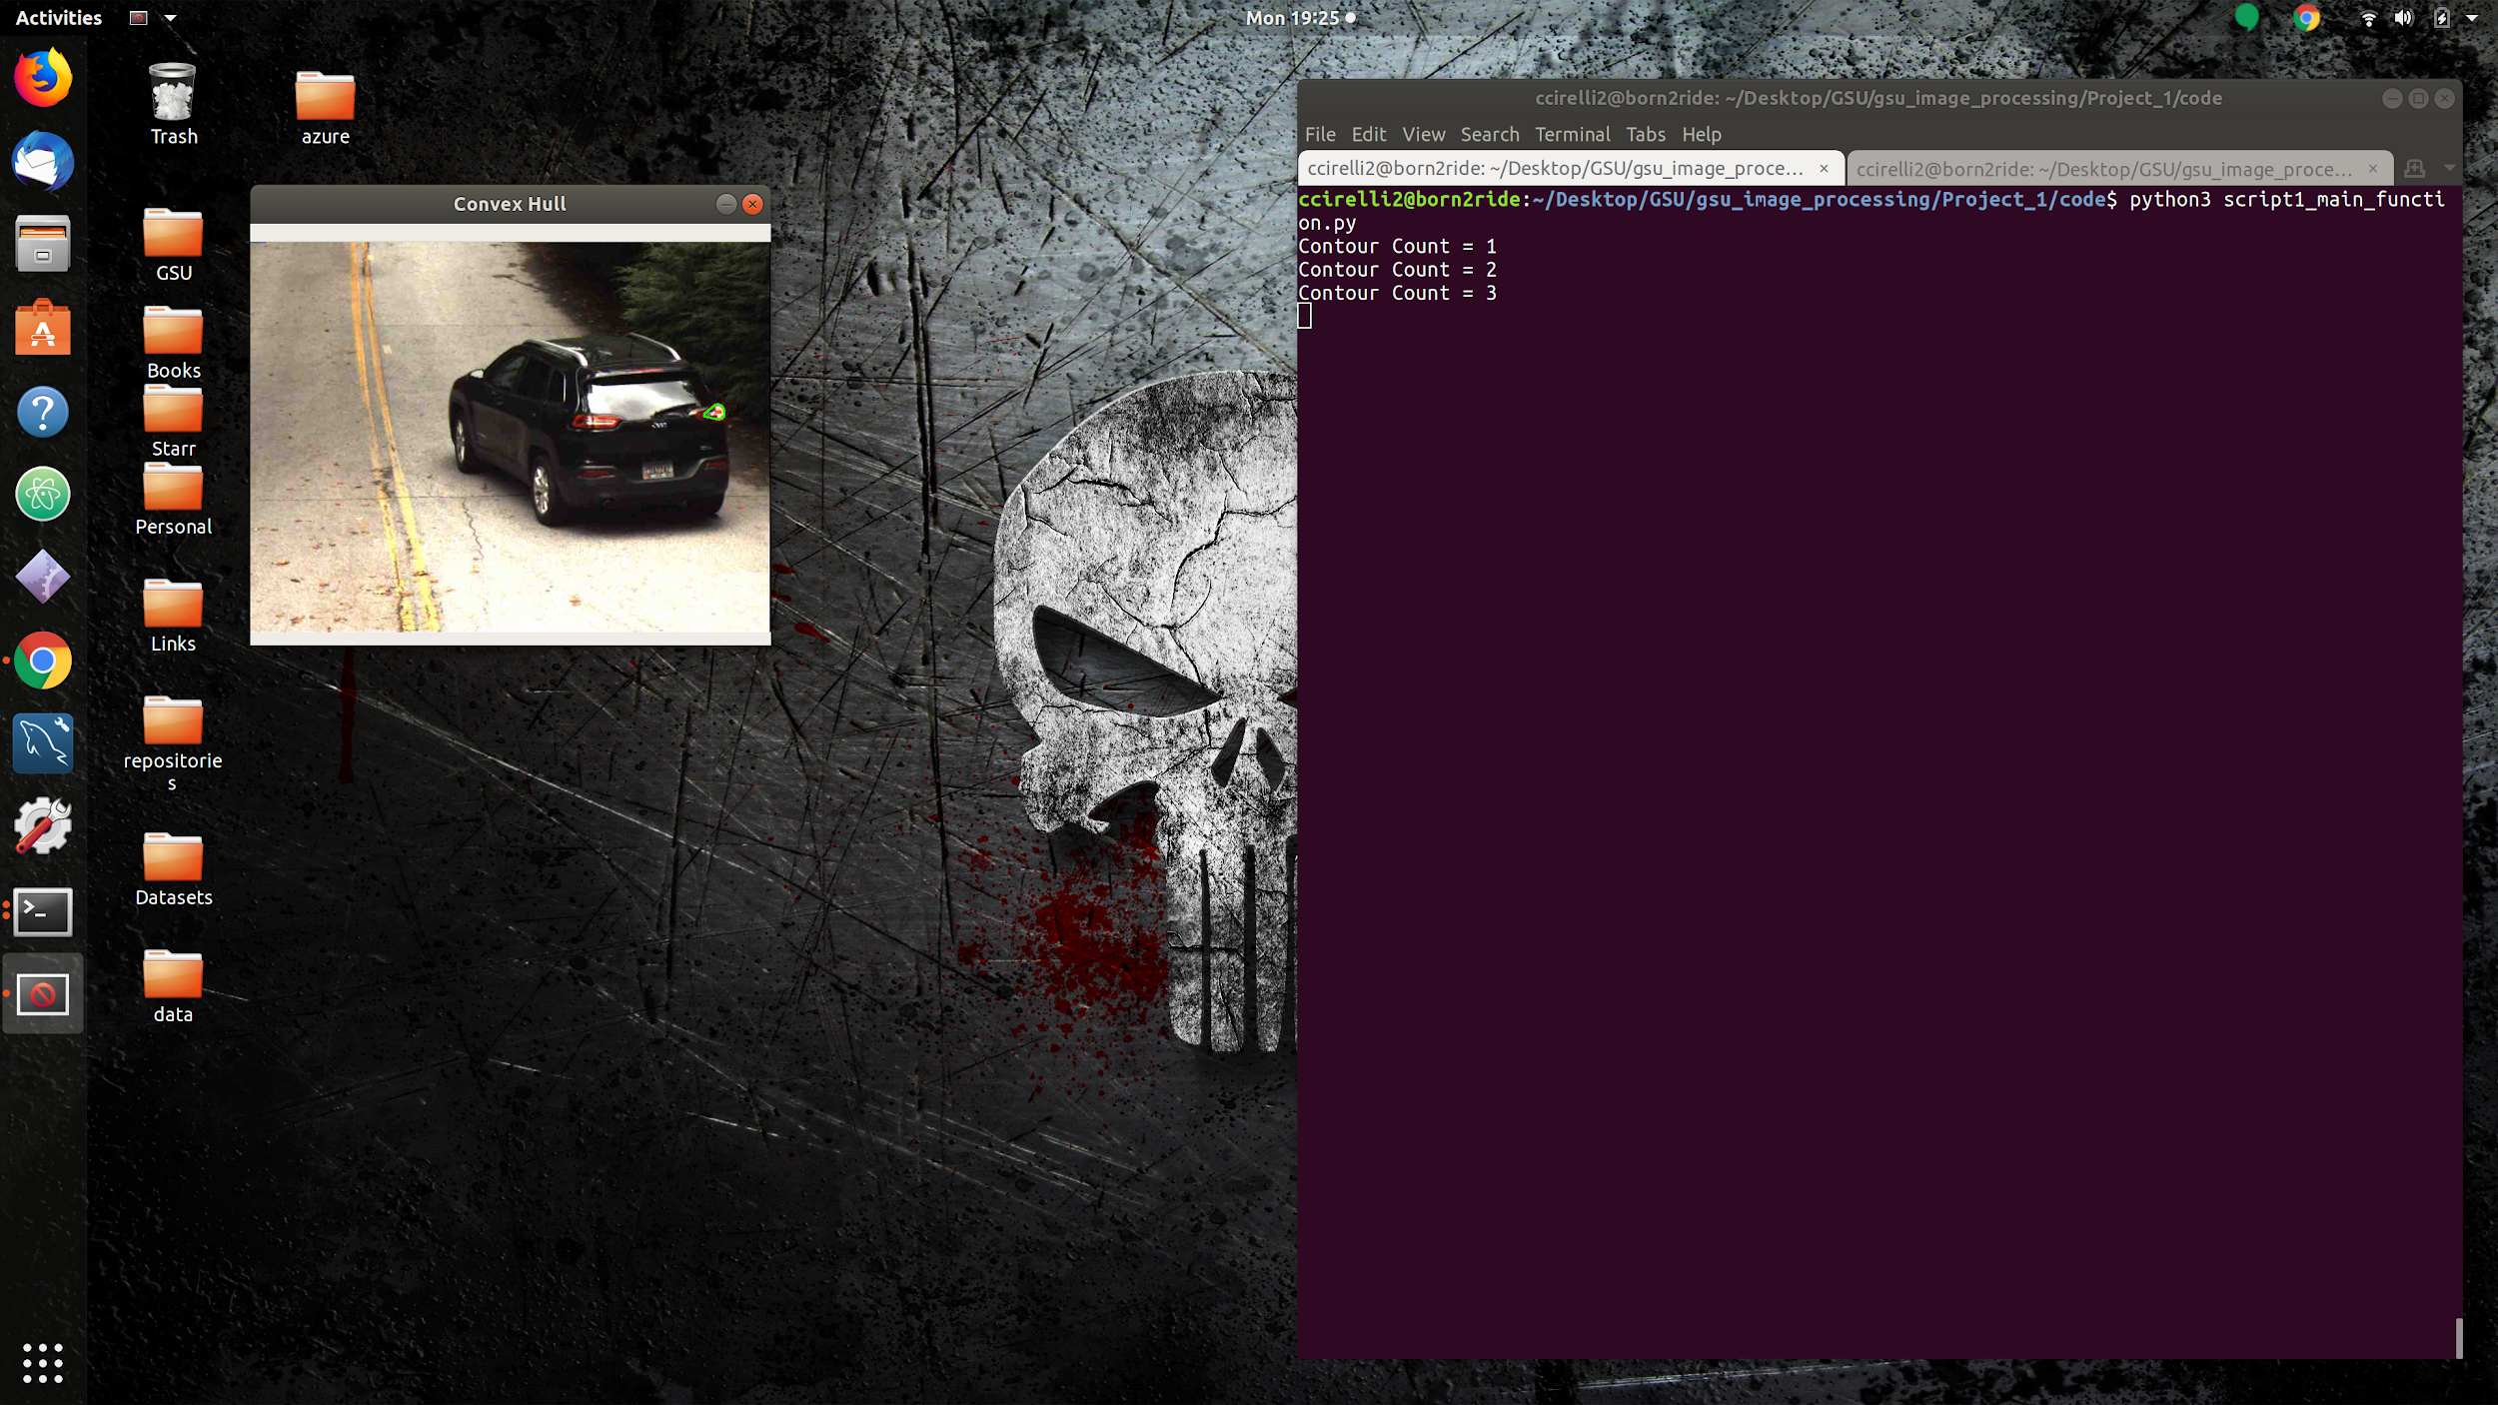
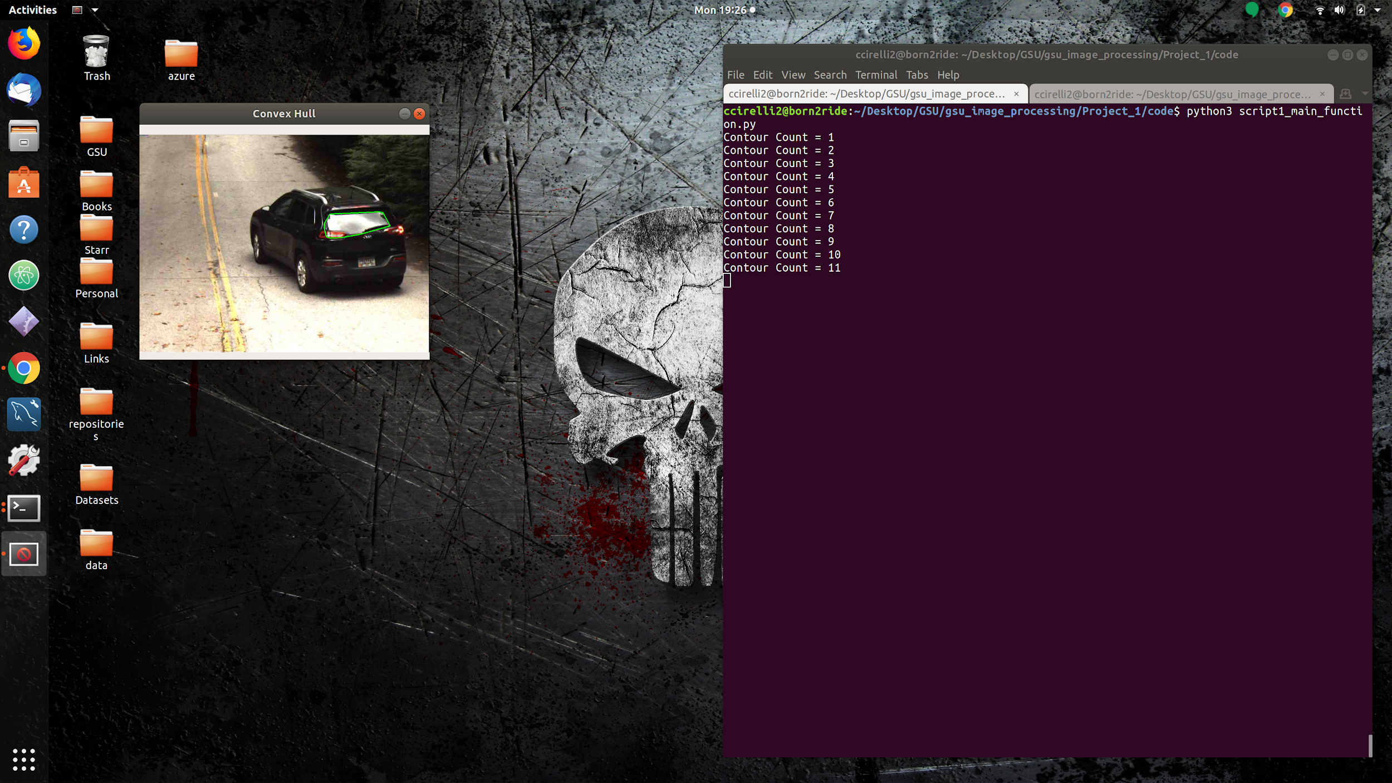


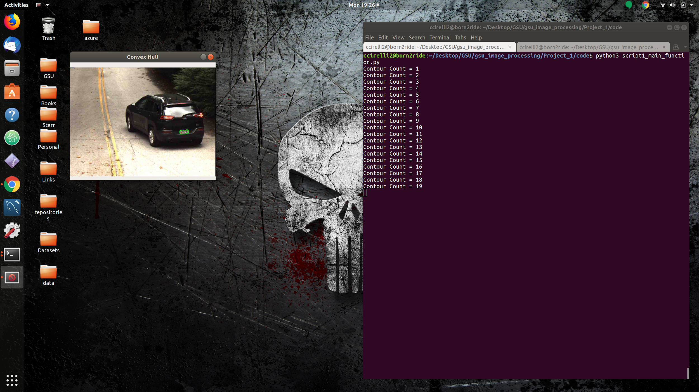
Examples of Different Contours
Characteristics:
All different sizes and shapes
Different shapes by similar areas
Boxlike shape but larger, smaller than plate (ex: rear window)
How can we narrow the scope of acceptable contours in order to maximize a likely match?

Slide 13
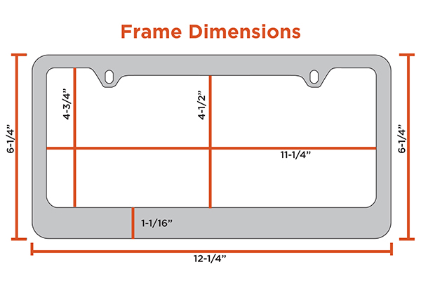
Approach1: Utilize dimensions of actual license plate
Observations:
Car license plates have unique and consistent dimensions.
Width > Height
Width 2* Height
Approach:
Add dimension thresholds to contours before seeking a match.
Utilize cv2.matchShapes
Notes:
https://www.learnopencv.com/shape-matching-using-hu-moments-c-python/

Slide 14
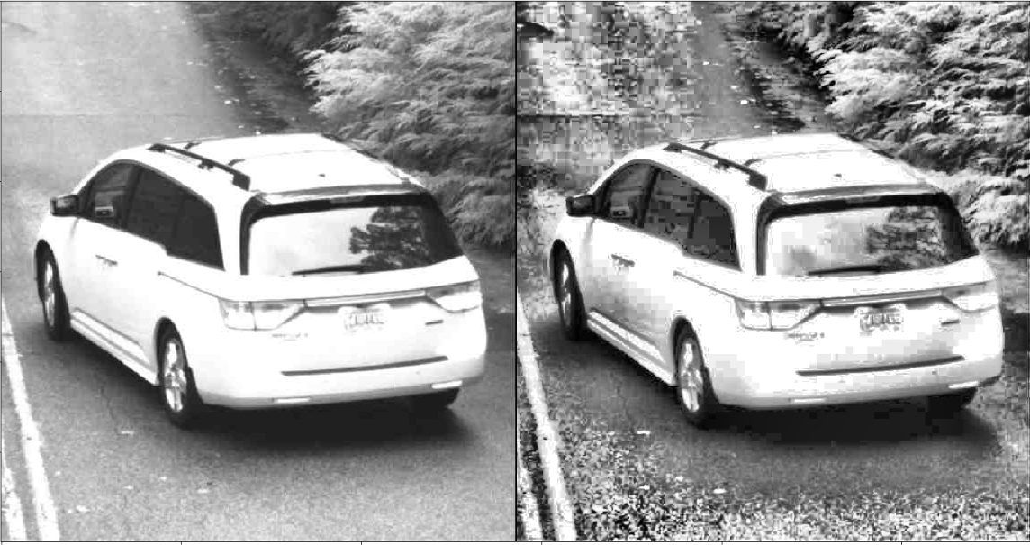
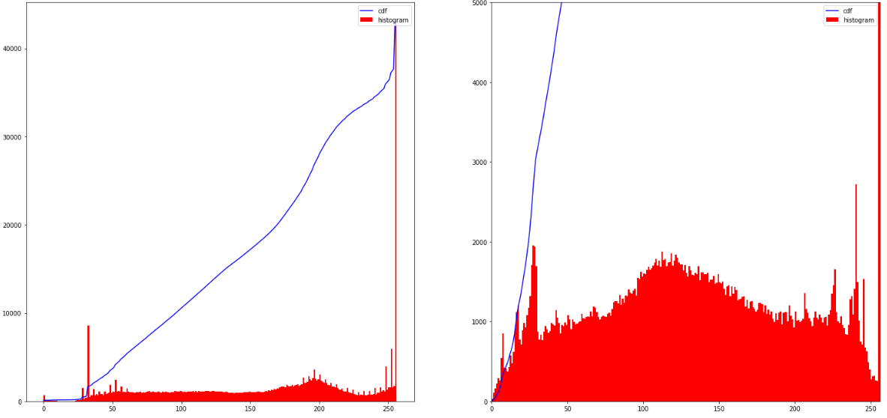
Approach2: CLAHE (Contrast Limited Adaptive Histogram Equalization)
Purpose
To emphasize the contrasts
Image Histogram
graphical representation of the intensity distribution of an image.
quantifies the number of pixels for each intensity value considered.
General Histogram Equalization
Normalizes the histogram globally.
CLAHE
Divide the image into small blocks and normalize the histogram

Slide 15
Optical Character Recognition

Slide 16
Optical Character Recognition
Challenge 1: Noise

Slide 17
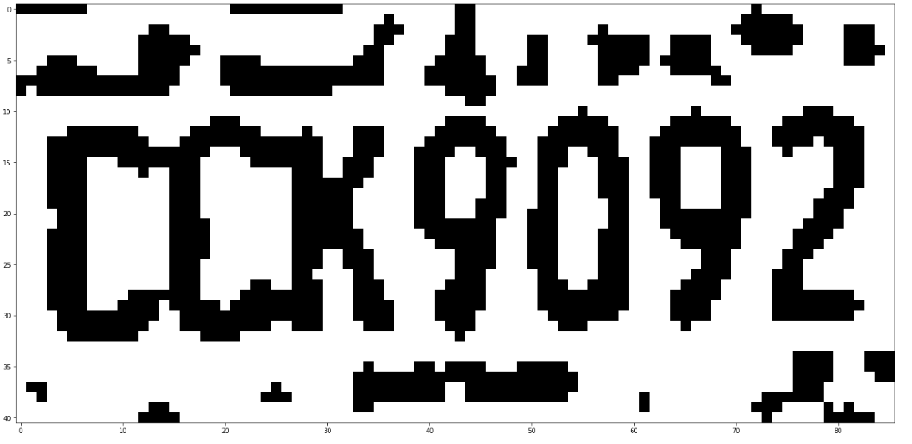
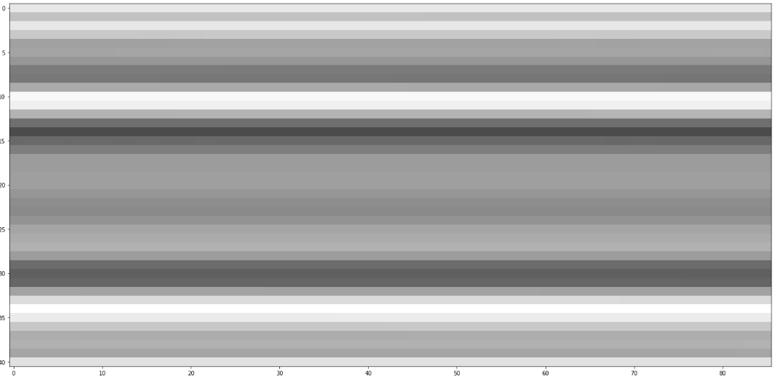
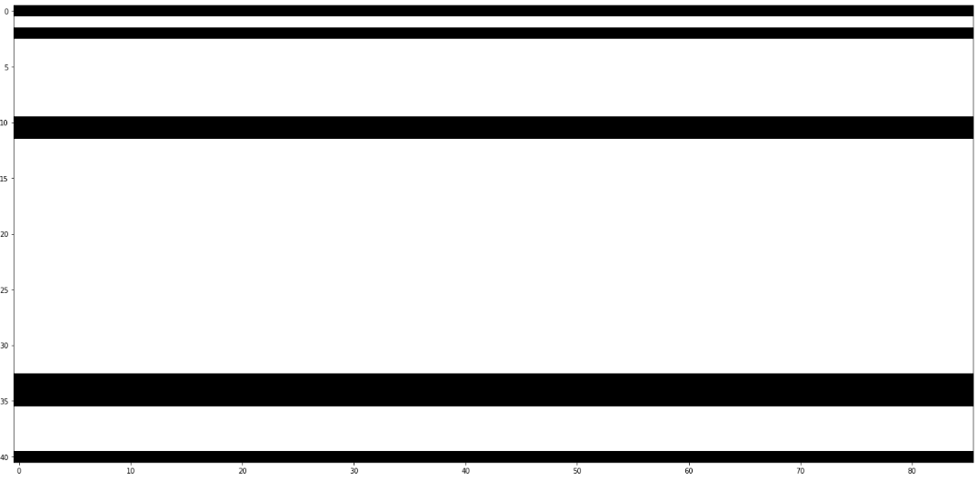
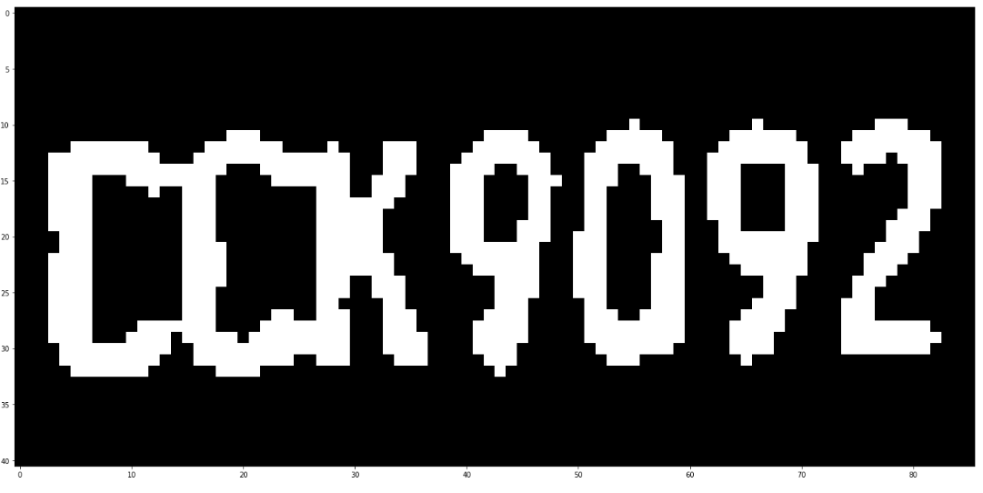
OCR Challenge 1: Noise
Original
b) Horizontal motion blur
c) Threshold of the motion blur
d) Mask applied

Slide 18
Optical Character Recognition
Challenge 2: Tilted

Slide 19
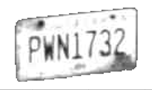
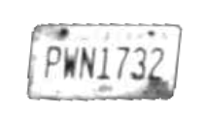
OCR Challenge 2: Tilted
Original
Applied Radon Transform

Slide 20
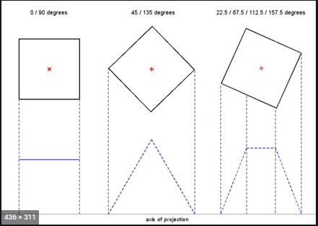
OCR Challenge 2: Tilted
Radon transform computes the projections of an image matrix along specified directions.

Slide 21
Optical Character Recognition
Challenge 3: Increase the Accuracy

Slide 22
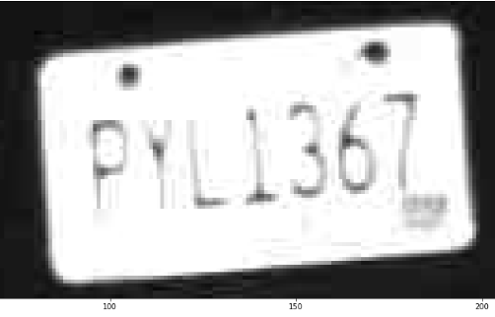
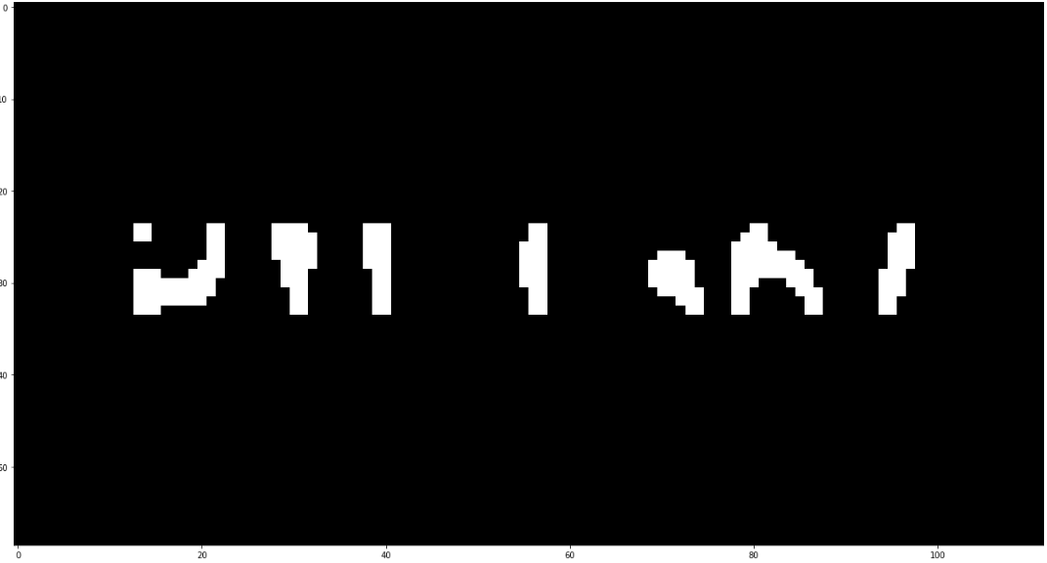
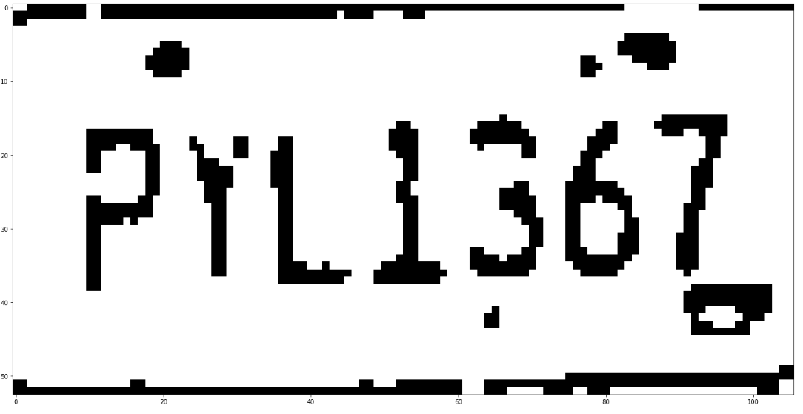
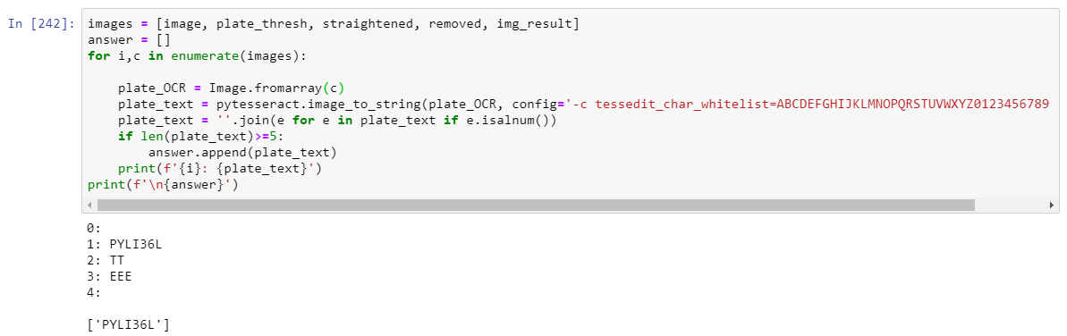
OCR Challenge 3: Increase the Accuracy

Slide 23
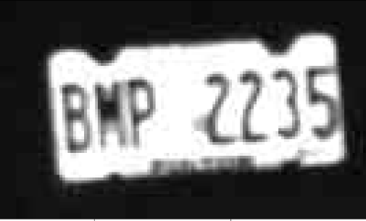
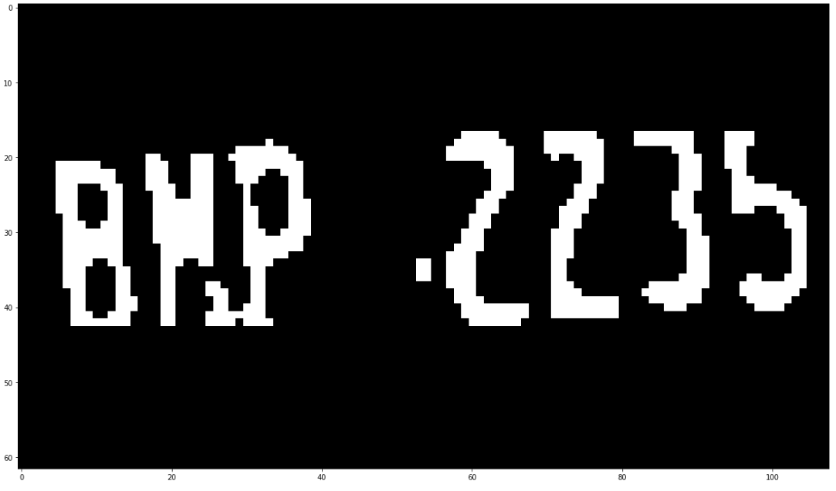
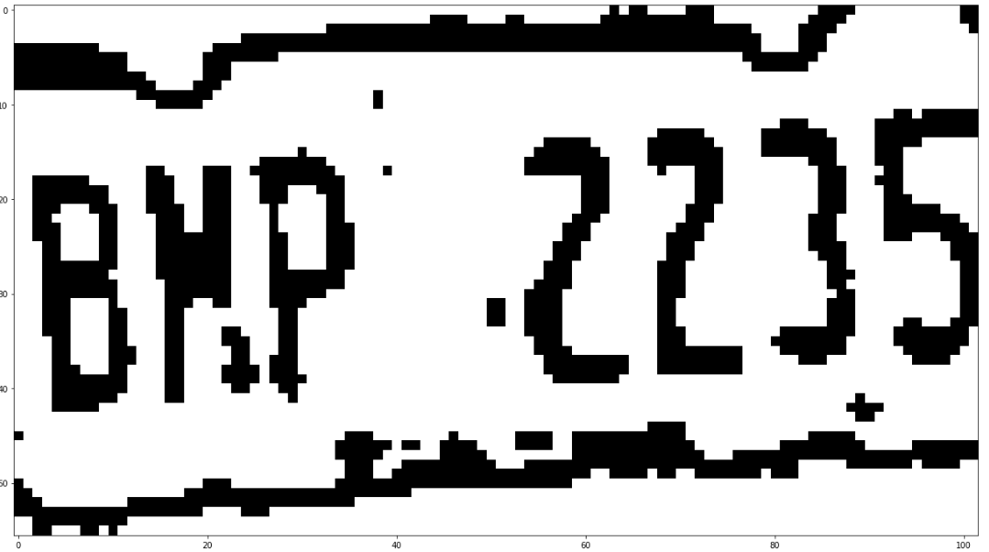
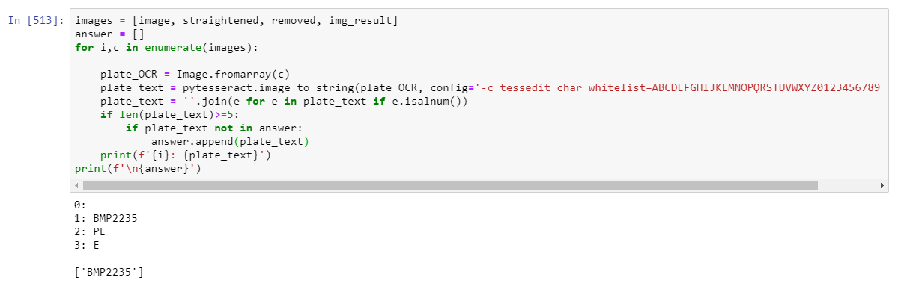
OCR Challenge 3: Increase the Accura

Slide 24
Results
License Plate Detection
License Plate OCR
Method:
Numerical (no cost funct.)
Results:
45% hit ratio on / around license plate
Method:
Results:

Slide 25
QUESTIONS?

